Slide 1
Data Science Case Studies
Team DS

Slide 2
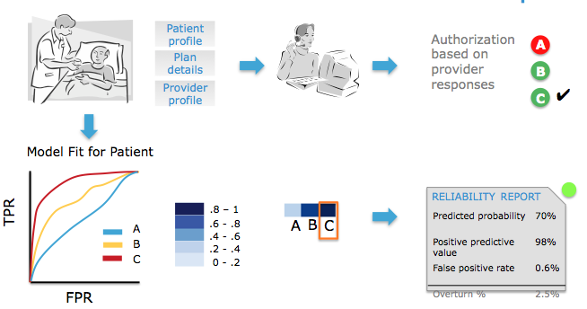
Healthcare Fraud/Waste/Abuse (FWA) Detection
Customer
Specialty Benefits Management
Business Problem
Pre-authorization FWA detection.
Challenges
Need for real time detection as retrospective pay and chase approaches are not effective
No training data labeled by medical professionals as fraudulent or wasteful
Solution needs to incorporate real time ordering physician data to patient history and physician profile data
Solution
Built models to predict physician responses to triage deviations from expected responses
600 models with custom feature sets trained in 3 minutes

Slide 3
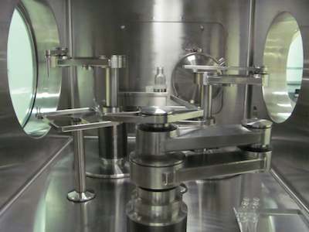

Vaccine Potency Prediction
Customer
A major pharmaceutical company
Business Problem
Predict potency and antigen levels of live virus vaccines based on manufacturing sensor data and manual data collected throughout the process.
Challenges
Customer’s data model was not optimal for running analytical queries
Manual data quality issues
Data capture was performed with varying consistency due to high cost associated with manual data collection
Solution
Introduced a new data model to make data accessible and enable analytics
Built automated outlier detection/correction methods to address manual data entry quality issues
Devised imputation methods to deal with data completeness issues
Built predictive models with high accuracy

Slide 4
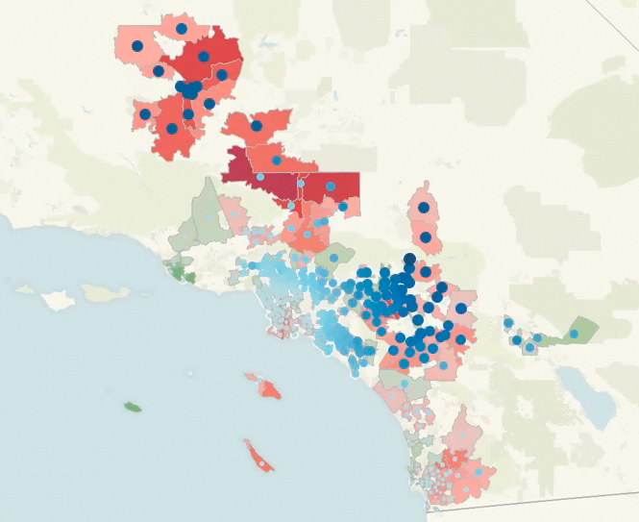
Real-time alert system for high-risk respiratory patients
Customer
Large vertically-integrated healthcare provider
Business Problem
The cost of treating respiratory patients is greatly increased by urgent care visits
Challenges
Identify urgent care risk factors and propose interventions to reduce risk of urgent care visit.
Solution
Predict risk of acute care encounter using prescription refill history, air quality data, and socioeconomic indicators.
Build a real-time application for alerting patients and physicians to take preventative action

Slide 5
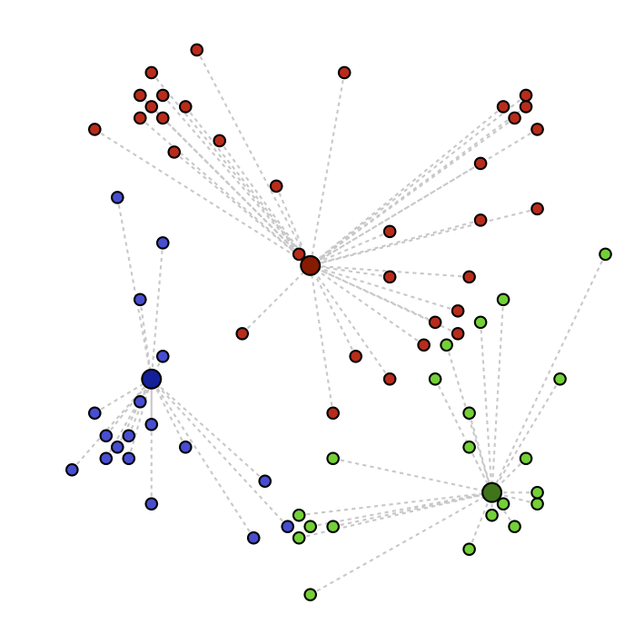
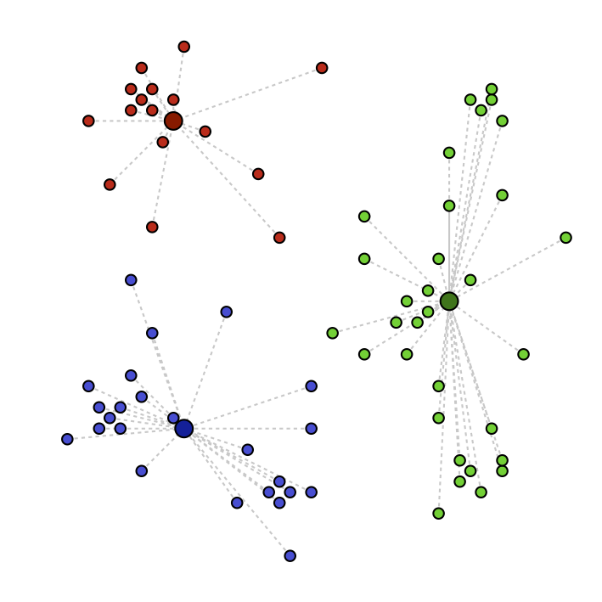
Constituent Segmentation
Customer
A major health insurance company
Business Problem
The company, in its analytics infancy, needed a foundational study to learn more about the consumers and providers it serves
Challenges
They had no way of connecting data across lines of business
There was no explicit data on profitability of consumers or providers
Solution
Created keys to connect information across LOBs
Clustered both the consumer and provider bases to learn about their makeup and preferences

Slide 6

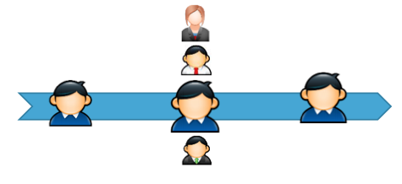
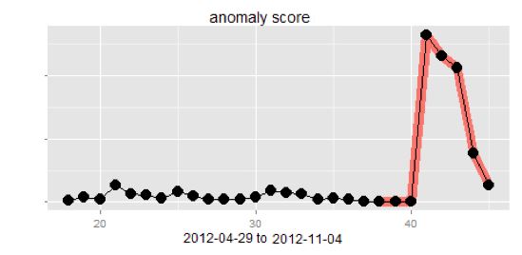
Network User Behavior Anomaly Detection
Customer
A major global financial service enterprise
Business Problem
Detect anomalous user behaviors in the global enterprise computer network
Challenges
10 Billions events in 6 months; 15K+ network devices; No existing SIEM solutions can model user behavioral resource access baseline and enable anomaly detection in an adaptive and scalable architecture.
Solution
An innovative Graph Mining based algorithmic framework with advanced Machine Learning. Network topology and temporal behaviors are both modeled. (Patent pending). Implemented in MPP and PL/R, enabling parallel model training and behavior risk scoring. Successfully identified DLP violating anomalous users.

Slide 7
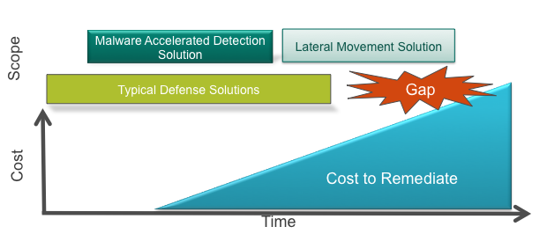
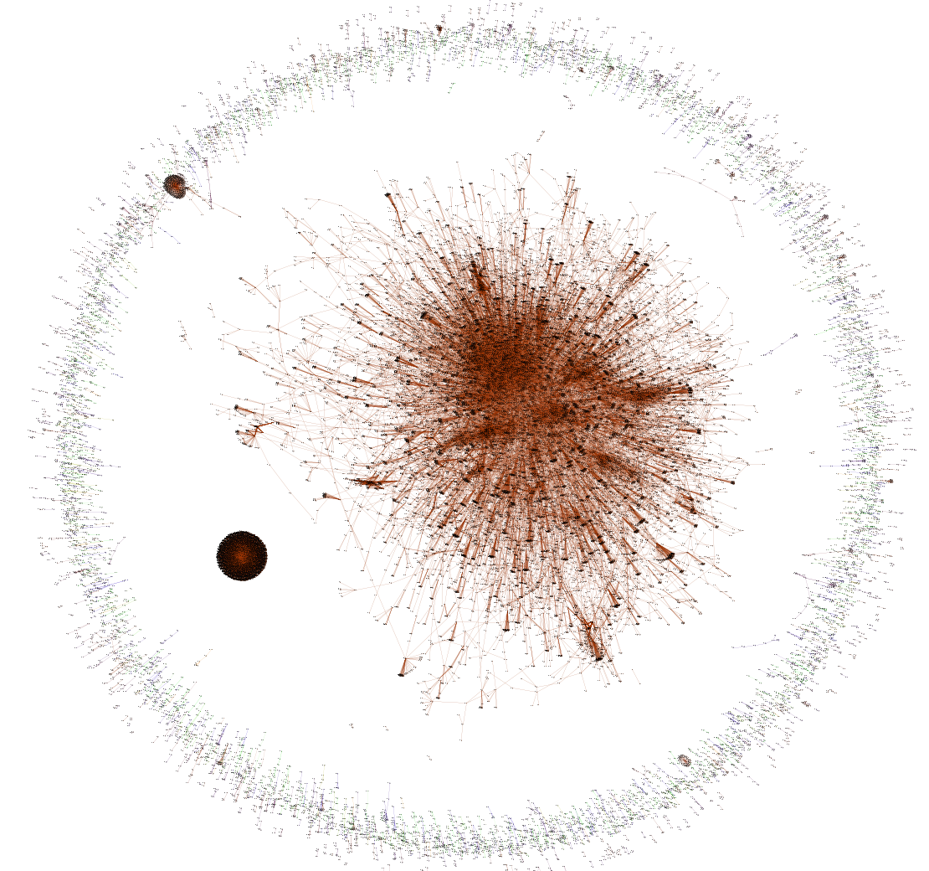
Network Intrusion Detection
Customer
One of the worlds largest health care providers
Business Problem
Detect advanced cyber threats in a large heterogeneous environment and to reduce malware ‘free-time’
Challenges
Covert threats employ advanced techniques to bypass traditional security appliances.
Last year 416 days was the median number before detection on a compromised network. (Source: Mandiant)
Solution
Built a new behavioral intrusion detection framework based on machine learning, graph theory and security research
Designed operational components of their next generation SIEM.
Engineered a full featured custom social graph based intrusion model
Identified breaches not a single security product they owned was able to detect
Firewall

Slide 8

First Party Banking Fraud Detection
Customer
A major financial institution
Business Problem
Detect 1st party or new account frauds in banking. Reduce account closure time from 30 or 60 days to within 2 weeks to reduce fraud exposure
Challenges
Proprietary data semantics from multiple tables. Domain knowledge of business process.
Solution
Engineer new feature correlate with frauds. Leverage cross-channel data and employ link analysis and other machine learning concepts to build a predictive model to identify bad accounts.

